Slide 1
Mvp and prototype

Slide 2
Mvp and prototype
Definition
MVP
It is the very first small version of your product for wider calculation.
Prototype
Prototype-first sketch of your idea

Slide 3
goal
MVP
The goal is to build smallest feature set.
PROTOTYPE
Exploring requirements
Choosing among alternatives
Empirical usability testing
Evolutionary development

Slide 4
MVP Vs. PROTOTYPE

Slide 5
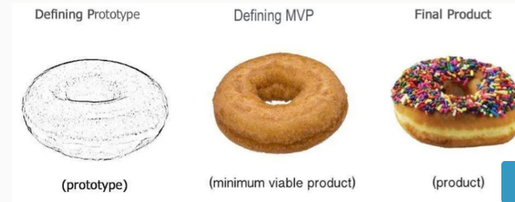
Product life cycle

Slide 6
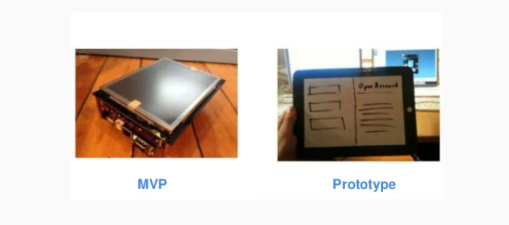
MVP vs. prototype

Slide 7
Why ?
MVP
Test product viability
Test assumptions
Test the market
Test product usability
Get user feedback
Prototype
Demonstrate the concept
Convince others
Get seed money

Slide 8
Who builds it ?
Mvp
Builds by minimal viable team
Evolutionary in its development
Prototype
Build by one guy
Usually throwaway in its development

Slide 9
target
Prototype
Innovators
Mvp
Early adopters groups
Educators
Influencers
Opinion makers

